Slide 1
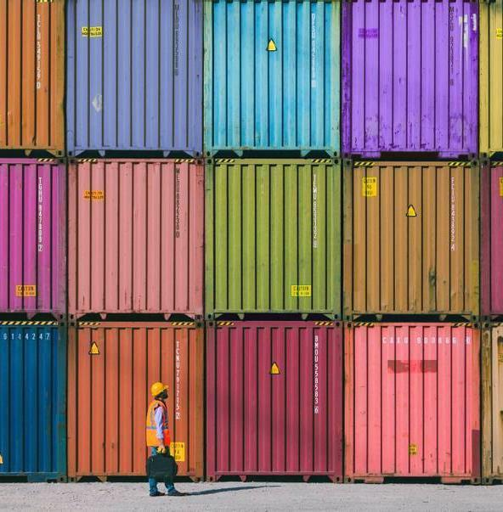
India's Crude Oil and Petroleum Products Trade : A Comprehensive Statistical Analysis
Submitted by –
Arghya Roy Chowdhury (A23007)
Arijit Mitra (A23008)
Kaustav Ghosh (A23023)
Under Guidance of :
- Dr. Sayantani Roy Chowdhury.

Slide 2
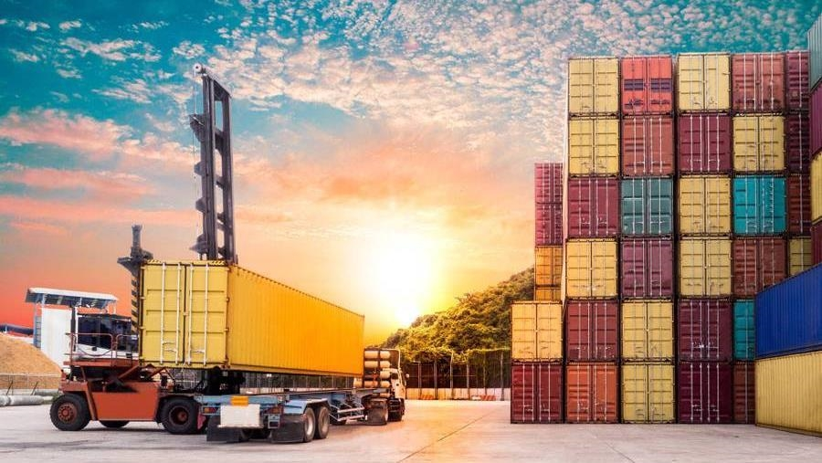
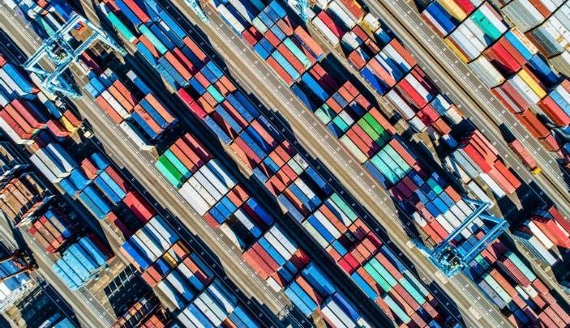
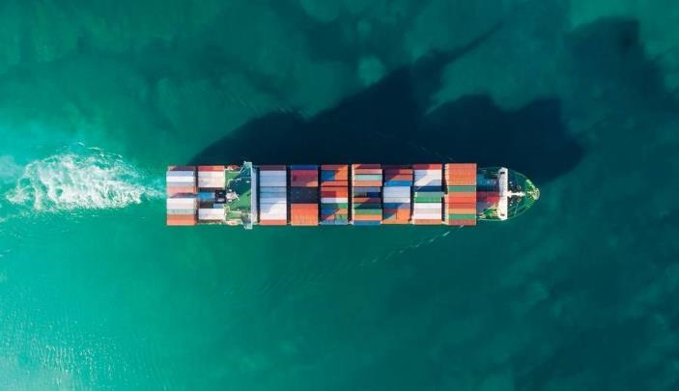
Problem Statement:
Problem Statement – The energy security of India solely depends on import of Crude oil and petroleum products and the very little amount of energy resources we generate on our own. Catering such a huge population mass is not an easy task for any country, especially a country like India where there is such diversity and requirements are diverse in accordance.
We as a country have always thought about the wellbeing of all human kind. Given the current climate crisis it’s an imperative for India to now think of shifting to renewable and non-conventional energy sources.
Our project solely puts light on -
The oil market of India and the fluctuations in it due to the changes in the Global Financial system.
The patches which we can exploit to achieve an orderly transition to green energy and also in behavioural changes.

Slide 3
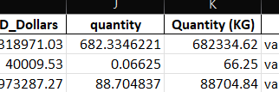



Data Processing and Methodology:
We created a new column ‘Quantity(KG)’ from the column quantity(1000 metric tonnes), for better and accurate computation of numerical analysis.
We inserted dates with accordance to the Year and Months Provided in the data so that we could forecast future trends of trade.
We imputed 12 null values, since it was less then 5% of the total records(3882) in the whole data set.
We divided the dataset into further sub-categories of import and export. Then we segregated the sub-categories into different time ranges of ‘Before Covid’, ‘During Covid’ and ‘After Covid’ to do trend analysis.
Data Collected From:
https://dataful.in/datasets/302/
https://ppac.gov.in/

Slide 4
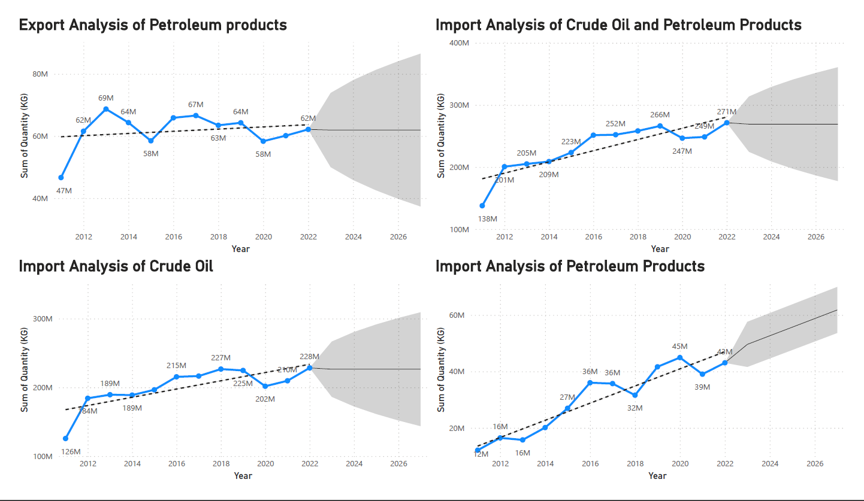

Slide 5
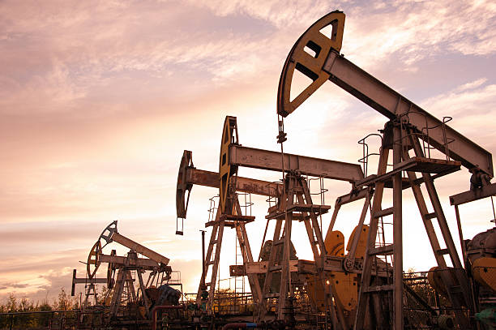
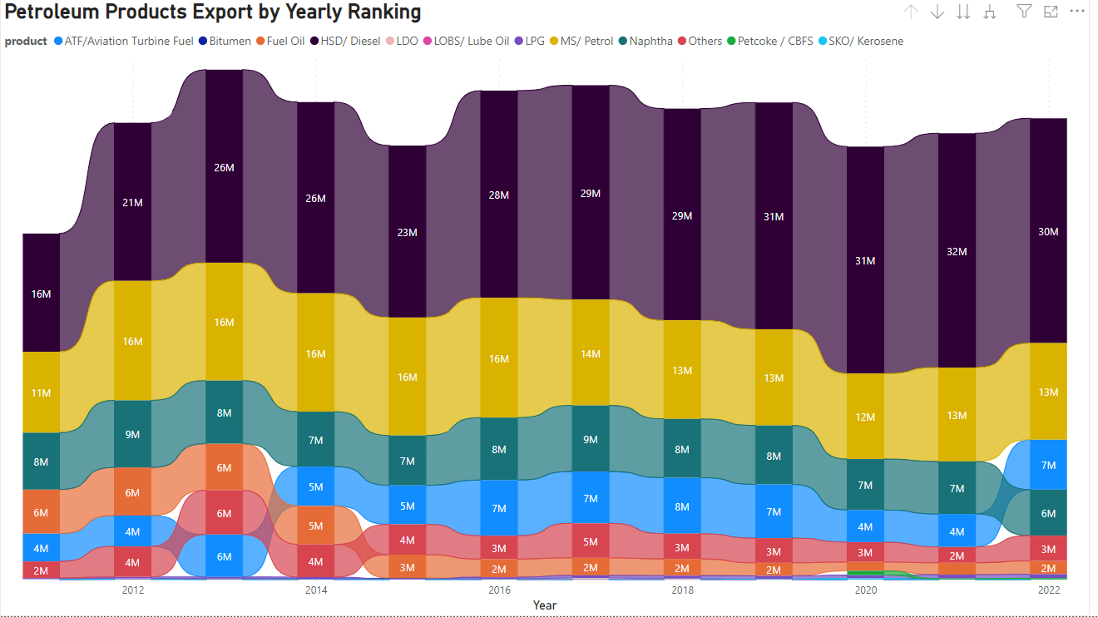
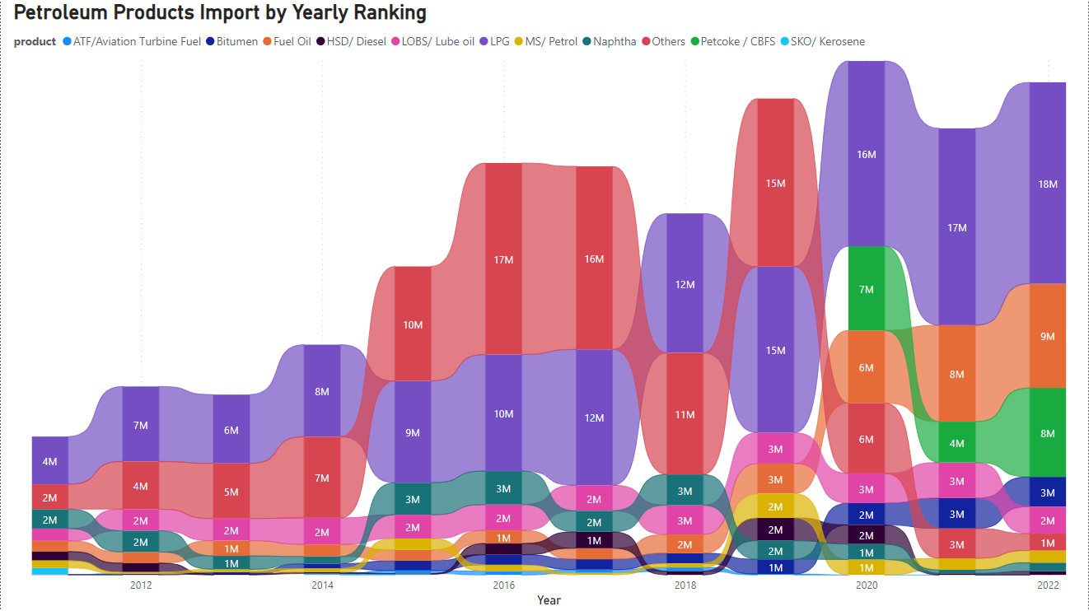
Highest : LPG, Other Products(Paraffin Wax, Petroleum Jelly, Aviation Gas, etc).
Lowest : Diesel, Petrol.
Highest : Diesel, Petrol, Naptha.
Lowest : LPG, Kerosene.

Slide 6
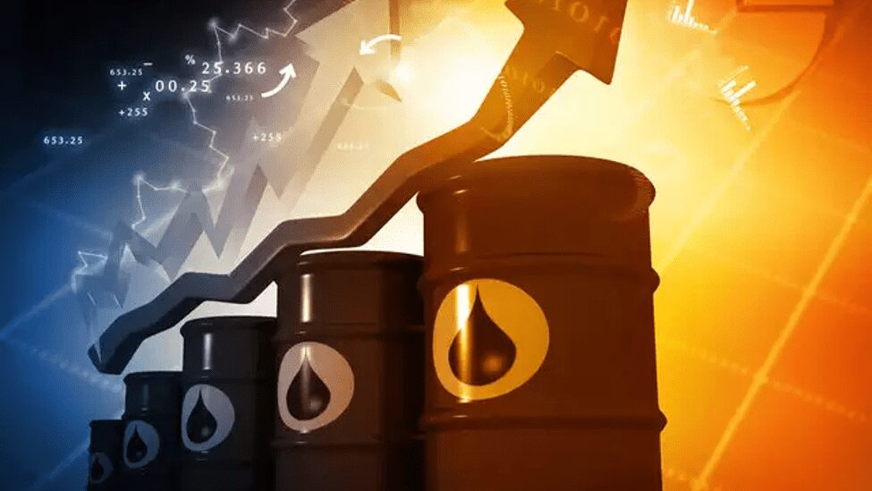
Numerical Analysis of Import and Export…..
Numerical Analysis of Quantity(KG) | Before Covid Export | During Covid Export | After Covid Export | Before Covid Import | During Covid Import | After Covid Import
Mean | 489851.893 | 415670.1014 | 431557.1202 | 1735068.927 | 1737718.263 | 1884980.504
Standard Error | 20068.69135 | 43593.06172 | 60462.40365 | 141863.3732 | 280526.1351 | 434906.1131
Median | 227099.427 | 59398.17175 | 49246.9634 | 111441 | 191196.457 | 158348.2615
Standard Deviation | 678487.9968 | 735935.5839 | 725548.8438 | 4821268.01 | 4735826.227 | 5218873.358
Kurtosis | 2.760684549 | 4.872320642 | 4.477963873 | 6.60803661 | 7.660956101 | 7.49350495
Skewness | 1.762280236 | 2.357892943 | 2.239173297 | 2.89636993 | 3.053293412 | 3.039098337
Range | 3370828.173 | 3403609.441 | 3364574.633 | 21101995.77 | 20489408.85 | 21626169.7
Minimum | 0 | 0 | 0 | 0 | 0 | 0
Maximum | 3370828.173 | 3403609.441 | 3364574.633 | 21101995.77 | 20489408.85 | 21626169.7
Sum | 559900713.7 | 118465978.9 | 62144225.31 | 2004004611 | 495249705.1 | 271437192.6
Count | 1143 | 285 | 144 | 1155 | 285 | 144
Export Numerical Analysis : The data suggests a decrease in the average, median, and total quantity of exports during and after the Covid period. Additionally, there is an increase in variability, skewness, and kurtosis, indicating a more dispersed and positively skewed distribution with a greater presence of extreme values to the right of the distribution.
Import Numerical Analysis : The data suggests an increase in the average, variability, skewness, and kurtosis in import quantities during and after the Covid period, indicating a positively skewed distribution with a greater presence of extreme values to the right of the distribution. The range and maximum values indicate the presence of extremely high import quantities.
SLIDE 5

Slide 7


CONCLUSION
A special focus on the importing trends of India pictures that throughout 2011 and 2019 India's import of Crude Oil and petroleum products have seen a steady growth except the patch of 2014 and 2015 where the prices of crude oil dropped and India imported crude oil and petroleum products very aggressively and then again the steady flow continued.
During COVID 19 in 2020 and 2021, India's energy consumption requirements went down, and along with that the price of crude oil in the international market went down too. There was a dip in importing of crude oil and petroleum products but that amount too was more than surplus for India's energy security. So India had a good stock pile of crude oil and petroleum products in the inventory.
Again in 2022 due to the Russia Ukraine war, Russia was under heavy sanctions from the West and Russia had to find out friendly allies who wanted to get Russian oil at extremely low rates, and India, having good relations with Russia ignored the sanctions and imported Russian crude oil at very cheap prices. Though after the COVID pandemic the energy requirements of India increased, this aggressive importing of Russian crude oil at very cheap prices again helped India to replenish it's inventory.
SLIDE 6

Slide 8

THANK YOU!!
Special Acknowledgement –
Mr. Rohit Pandey.
Our Fellow Classmates.
Respected Faculties.

